Slide 1
CST8101 Computer Essentials
Microprocessor

Slide 2
Microprocessor
Central Processing Unit (CPU)
Can perform millions of mathematical operations per second
Responsible for most of the data processing performed by the computer
Often referred to as the brains of the computer

Slide 3
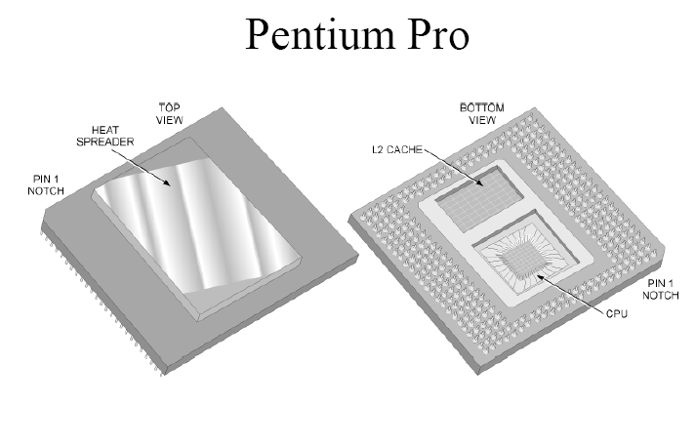
CPU

Slide 4
Microprocessor
Clock
The clock speed or clock rate is the speed at which the microprocessor executes instructions
It is the maximum speed, not the speed at which it always runs
This internal clock is used to regulate the rate at which instructions are executed and to synchronize all the various computer components
The CPU requires a fixed number of clock cycles to execute each instruction
Every instruction requires at least two clock cycles
Notes:
bb

Slide 5
Microprocessor
Front Side Bus or FSB
Communication device between the CPU and the Northbridge and Southbridge (device such as RAM, Expansion Slots, HD)
Communication is bi-directional
Back Side Bus
Connects the CPU to the L2 and L3 Cache
Faster than the FSB

Slide 6
Microprocessor
FSB and BSB have since been replaced with QPI
QuickPath Interconnect or QPI
Allows direct communication between the CPU and/or RAM, Expansion Slots, HD simultaneously.
Communication is bi-directional
Much Faster than FSB

Slide 7
Quick Path Interconnect
Organized very similarly to the OSI model
Physical layer
The actual circuits connecting devices.
Link layer
Implements flow control.
Routing layer
The routing layer sends a 72-bit unit consisting of an 8-bit header and a 64-bit payload.

Slide 8
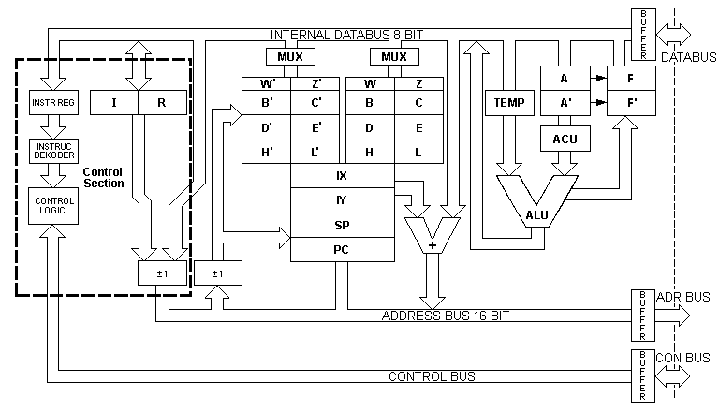
Simple CPU – The Z80
Bus Interfaces
Arithmetic Logic Unit
Control Unit
Registers

Slide 9
CPU Components Z-80
Execution (Control) Unit
Decodes instructions
Makes logical decisions
Arithmetic Logic Unit
Performs integral calculations
Performs comparisons
Registers
Temporary storage spaces
Known as general purpose registers: AX, BX, CX, DX
NOT memory addresses
Used for data manipulation by the CPU
Bus Interfaces
Physical connections between CPU and three-bus architecture

Slide 10
Arithmetic Logic Unit
Equal-to condition. In a test for this condition, the arithmetic/logic unit compares two values to determine if they are equal.
Less-than condition. To test for this condition, the computer compares values to determine if one is less than another.
Greater-than condition. In this type of comparison, the computer determines if one value is greater than another.
A computer can simultaneously test for more than one condition. In fact, a logic unit can usually discern six logical relationships: equal to, less than, greater than, less than or equal to, greater than or equal to, and not equal.

Slide 11
Registers
Computers usually assign special roles to certain registers, including these registers:
An accumulator, which collects the result of computations.
An address register, which keeps track of where a given instruction or piece of data is stored in memory. Each storage location in memory is identified by an address, just as each house on a street has an address.
A storage register, which temporarily holds data taken from or about to be sent to memory.
A general-purpose register, which is used for several functions.

Slide 12
Microprocessor
Three-Bus architecture
Allows the CPU to specific type, size and location of data transfer
Control bus
Identifies whether the CPU is reading or writing data
Address bus
Identifies the location of where the data is being read/written
Data bus
Actual information being sent/received by the CPU

Slide 13
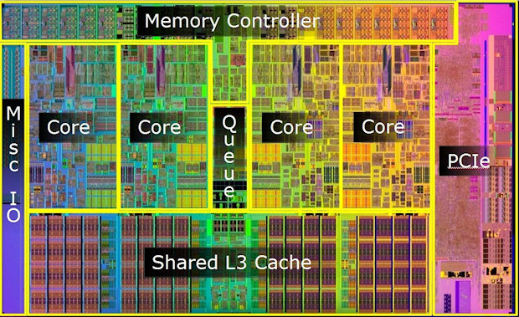
Block diagram of Intel 900 series processor die image from Intel

Slide 14
CPU Execution Cycle
The CPU executes every program one instruction at a time
Typically instructions are very simple, for example
MOV
Copy data to/from memory
CMP
Compare two values
ADD
Add two numbers together
JMP
Set the Program Counter to a new address
Etc.

Slide 15
CPU Execution Cycle
Each CPU instruction must experience three phases
FETCH
Data is read from memory, and transferred to CPU’s control unit
DECODE
CPU determines what is required to perform the instruction
EXECUTE
CPU performs the instruction

Slide 16
CPU Execution Cycle
For complex instruction sets, this cycle can be quite costly in terms of time
Numerous optimizations have been developed to speed the process along
Such as …
Wider Busses
Pipelining
Superscalar Architectures
Branch Predictor
Cache memory

Slide 17
Performance Enhancements
Wider Data Busses
Simply increased the number of wires connecting the CPU
Data bus width has grown from 8 bits (Intel 8088) to 64 bits (for Dual Channel DDR)
Allows more data to be carried simultaneously between CPU and memory
Similar to more lanes on a highway

Slide 18
Pipelining
All CPUs have a pipeline that the CPU uses to process a command
With a single pipeline all commands. Simple or complex, run through the same linear pipeline
Dual pipeline
Dual pipelining allows two instructions to be processed at the same time
The first pipeline, named U is the primary
The second pipeline, named V can handle simple commands such as integer addition

Slide 19
Pipelining
Quad pipelining
Able to handle four separate pipelines simultaneously
On average, this enabled the equivalent of three simultaneous processes
Dynamic processing
Some time consuming actions could cause the CPU to wait up to 10 to 20 clock cycles
When the CPU was forced to wait, it took advantage of the wait to look at the pipeline to see if any other commands where complete
Pentium IV allowed a pipeline depth of 20 stages or more

Slide 20
Pipelining
Pipeline stages
Each stage allows a portion of instruction decode and execution to occur
Typical stages include
instruction fetch
instruction decode
memory read
ALU operation
memory write

Slide 21
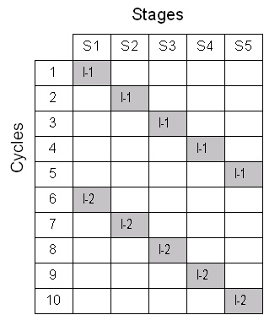
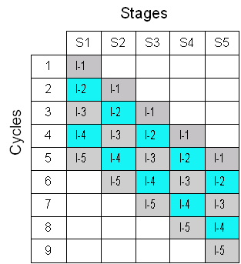
Pipelining Illustrated
The advantages of pipelining
Non Pipelined Pipelined
Single Instruction Multiple Instructions

Slide 22
Performance Enhancements
Superscalar Architectures
If one pipeline is good …
Multiple pipelines may be better!
Superscalar implements multiple CPU pipelines
Permits multiple instructions to be executed simultaneously

Slide 23
Branch Predictor
Originally found on high-end mainframe processors
Requirement for efficiently using a deep pipeline
By default, programs execute sequentially .. Instructions executed in the same order as they appear in memory

Slide 24
Branch Predictor
Branch Prediction Unit (BPU) permits CPU to anticipate where the next program branch will come from
Processor is able to keep instruction pipeline full at high speeds
Part of Intel’s Advance Dynamic Execution (ADE) engine – component in Pentium IV design

Slide 25
Cache Memory
Cache allows CPU very quick temporary storage for often-used data
Similar to a high-speed buffer only more intelligent
To cache means to set aside data used in the past in a fast storage area
When the CPU needs that data again is can easily and quickly access the data

Slide 26
Cache Memory
How caching works:
The cache controller anticipates what data will be required next
Intel states that their processors are correct around 90% of the time
Three levels of processor cache exist in modern computers
Level 1
Level 2
Level 3

Slide 27
Cache Memory
Level 1 (L1) Cache
Originated with the 486 family of processors
Ranges from 8 KB to 64KB
Integrated into the CPU
Runs at the full core speed of the CPU
Processors always run faster than the data bus

Slide 28
Cache Memory
Level 2 (L2) Cache
Up to 1 MB of storage
Originally ran slower than L1 cache
Now CPU resident for Pentium class and running at the processor speed
Acts as secondary buffer between system memory and CPU

Slide 29
Cache Memory
Level 3 (L3) Cache
Resides on the CPU
Older AMD/Intel CPU’s have L3 cache residing on the motherboard
Size of the Cache on Processors range from 512 KB to 8 MB

Slide 30
Multimedia Instructions Sets
MMX
Acronym - does not stand for anything
Circuit in the CPU that is used to speed up the execution of multimedia code such as graphics and sound
Performs a single instruction on multiple data – often called a SIMD

Slide 31
Multimedia Instructions
SSE
70 new instructions were added to MMX to speed up processing in 1999
SSE2
144 new instructions
SSE3
13 new instructions – released in with the Prescott Pentium 4

Slide 32
Other Performance Factors
Performance factors include
CPU clock speed
CPU bus speed
Chipset
RAM type and amount
Etc, etc
The only thing that’s constant in technology, is change!

Slide 33
Microprocessor Comparison
Comparison chart for Intel processors
Name | Date | Transistors | Microns | Clock Speed | Data Width | MIPS
8080 | 1974 | 6,000 | 6 | 2 MHz | 8 bits | 0.64
8088 | 1979 | 29,000 | 3 | 5 MHz | 16 bits 8-bit bus | 0.33
80286 | 1982 | 134,000 | 1.5 | 6 MHz | 16 bits | 1
80386 | 1985 | 275,000 | 1.5 | 16 MHz | 32 bits | 5
80486 | 1989 | 1,200,000 | 1 | 25 MHz | 32 bits | 20
Pentium | 1993 | 3,100,000 | 0.8 | 60 MHz | 32 bits 64-bit bus | 100
Pentium II | 1997 | 7,500,000 | 0.35 | 233 MHz | 32 bits 64-bit bus | ~300
Pentium III | 1999 | 9,500,000 | 0.25 | 450 MHz | 32 bits 64-bit bus | ~510
Pentium IV | 2000 | 42,000,000 | 0.18 | 1.5 GHz | 32 bits 64-bit bus | ~1,700

Slide 34
About the Chart
Transistors
The number of transistors on the chip
Notice the number of transistors has steadily gone up
Microns
The width, in micros, of the smallest wire on the chip
A human hair is 100 microns thick

Slide 35
About the Chart
Data Width
Is the width of the ALU
An 8-bit ALU can manipulate two 8 bit numbers
MIPS
Is roughly the performance rating for the CPU
Stands for “millions of instructions per second”

Slide 36
Lecture Summary
Major CPU Components
Control Unit, ALU, Busses
FPU, Branch Predictor, Cache
Performance Factors
Wider busses, pipelining, superscalar architecture, branch predictor, cache

